Slide 1
SRE
Notes:
What does the Product team do?
We ask a lot of questions; understand what the market wants, and what we’re able to provide; prioritize based on this; work cross-functionally; line-of-business owners.

Slide 2
SRE – Site Reliability Engineering
Who are we ?
Site Reliability Engineering (SRE) is a discipline that incorporates aspects of software engineering and applies them to infrastructure and operations problems. In summary we ensure Business continuity for our customers.
What we do ?
SRE Prime objective is to ensure
Monitoring
Application availability
Data availability
Business continuity
Incident management
Automation - reduce manual efforts.
How we do ?
Tools - DataDog , Nagios, Email Alerts, Pager Duty.
Collaboration – Slack, Microsoft Teams, Webex ,Zoom.
Stakeholders - CS , BCS, Customer, L4/Eng.
Confidential
Notes:
Which of these is most important?
New communication & collaboration channels are constantly emerging
Channels used for “business as such” need to be archived and supervised
Internal as well as external communications
Employees are adopting new channels across multiple devices
Mobile first is new reality
Productivity and anywhere/anytime connectivity are the key drivers
Need to capture rich, conversational context from dynamic tools
Conversion to generic email format destroys context
Altering during capture breaks “chain of custody”
Preserving context enables rich & granular search experience
Regulators are increasingly focusing on new communication sources
Recent focus on social and mobile compliance guidance
With rapid adoption, collaboration platforms likely to gain regulator focus
Cycle progressing from guidance to enforcement with escalating penalties
Proactively manage policy violations
Inline, real-time visibility
Remediate externally posted content in near-real time if it violates policies
Identify and act upon policy violations – before they hit the archive
Unstructured communications residing in disparate systems creates gaps

Slide 3
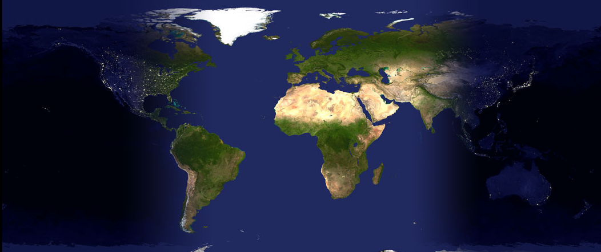
SRE Working Model
SRE follows FTS model “Follow the sun” . Modern day software development is spread more and more across national and international boundaries. Global software development (GSD) is now the need of the hour more than ever. FTS one of the important concepts evolved in the past decade for software development.
We are currently spread across below 4 Time Zones with very skilled and enthusiastic people.
RWC(PST)
ATLANTA (EST)
UK (GMT)
BLR (IST)

Slide 4
Q & A

